Slide 1

Netflix Content Analysis: Trends and Strategic Recommendations
Siva Prakash S
Apply ID: APPLY_1755230181689eafe538d00
Internship ID: INTERNSHIP_17546440516895be537820f

Slide 2

PROBLEM STATEMENT
Content Strategy Analysis
Background: In a competitive streaming market, Netflix needs to optimize its content library to drive growth and maintain market leadership.
The Challenge: To analyze the Netflix catalog (7,789 titles from 2008-2021) to identify key trends and inform future content strategy.
Key Objectives:
Analyze Content Mix: How has the balance of Movies vs. TV Shows evolved?
Identify Popular Genres: What are the most dominant content genres on the platform?
Map Global Footprint: Which countries are the top contributors to the content library?
Expected Outcome: Actionable, data-driven recommendations to guide content acquisition, production, and global expansion efforts.

Slide 3
Project Description
1. Introduction & Motivation
This project undertakes a comprehensive analysis of the Netflix content library to derive actionable insights for strategic decision-making. In an increasingly competitive global streaming market, a data-driven approach to content acquisition and production is essential for maintaining market leadership and driving subscriber growth. This analysis leverages a dataset of nearly 8,000 movies and TV shows to uncover trends, patterns, and opportunities within the Netflix catalog.
2. Scope & Methodology
The analysis is focused on a publicly available dataset containing Netflix titles released between 2008 and 2021. The core methodology involves:
Data Preprocessing & Cleaning: Handling missing values, correcting data types, and ensuring the dataset is clean and consistent for accurate analysis.
Exploratory Data Analysis (EDA): Using descriptive statistics and visualizations to explore key dimensions of the dataset.
Trend Analysis: Specifically examining the evolution of content over time, including the mix of movies vs. TV shows, the popularity of genres, and the geographical distribution of content production.
3. Key Objectives
The primary goal is to answer critical business questions by achieving the following objectives:
Analyze the Content Mix: Track and visualize the year-over-year distribution of movies versus TV shows to understand shifts in content strategy.
Identify Dominant Genres: Determine the most prevalent genres on the platform to identify key areas of content strength.
Map Global Content Sources: Analyze and rank the top countries contributing content to the Netflix library to understand its global production footprint.
4. Expected Deliverables & Outcomes
The project will culminate in a set of clear, data-backed deliverables:
Visualizations: A series of charts and graphs illustrating trends in content type, genre popularity, and country contributions.
Key Findings Summary: A concise report detailing the primary insights discovered during the analysis.
Strategic Recommendations: Actionable recommendations for Netflix's content team regarding future investments in specific content formats, genres, and regional markets.

Slide 4

WHO ARE THE END USERS?
Primary End Users (The Decision-Makers)
These are the teams who will directly use the insights to make strategic decisions.
Content Strategy & Acquisition Team:
Why: They are responsible for acquiring new content and managing the content budget.
Netflix Originals Production Team:
Why: This team develops and produces original Netflix content.
Senior Leadership & Executives (e.g., Chief Content Officer, Regional Directors):
Why: They are responsible for the overall business strategy, budget allocation, and long-term vision.
Secondary End Users (The Influencers)
These teams will be interested in findings to support their own functions.
Marketing & Programming Teams:
Why: They are responsible for promoting content to subscribers.
Data Science & Analytics Teams:
Why: They build predictive models and conduct deeper analysis.

Slide 5

Technology Used
Programming Language:
Python: A versatile and powerful language with extensive libraries for data analysis.
Development Environment:
Google Colab: An interactive, cloud-based notebook environment that allows for seamless coding, analysis, and collaboration.
Core Python Libraries:
Pandas: For data manipulation, cleaning, and structuring the dataset.
NumPy: For efficient numerical operations.
Matplotlib & Seaborn: For creating insightful and high-quality data visualizations.

Slide 6
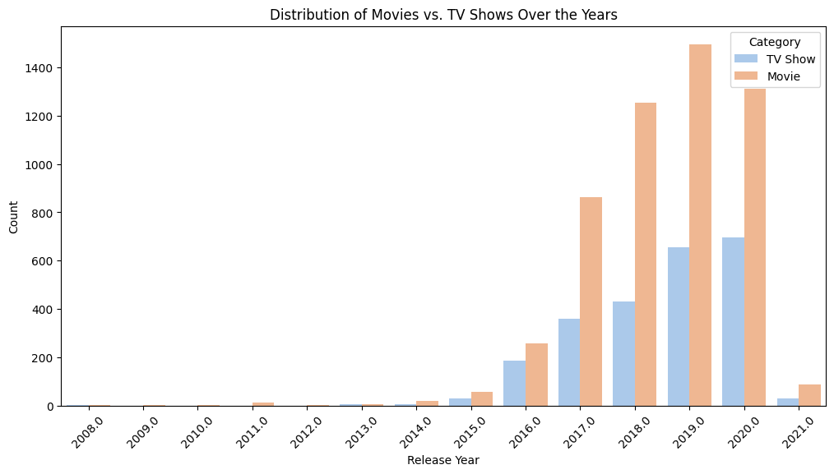
RESULTS1

Slide 7
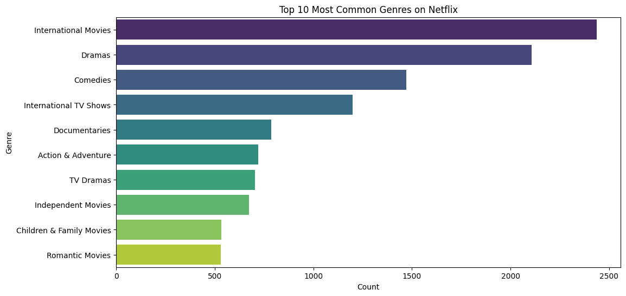
RESULTS2

Slide 8
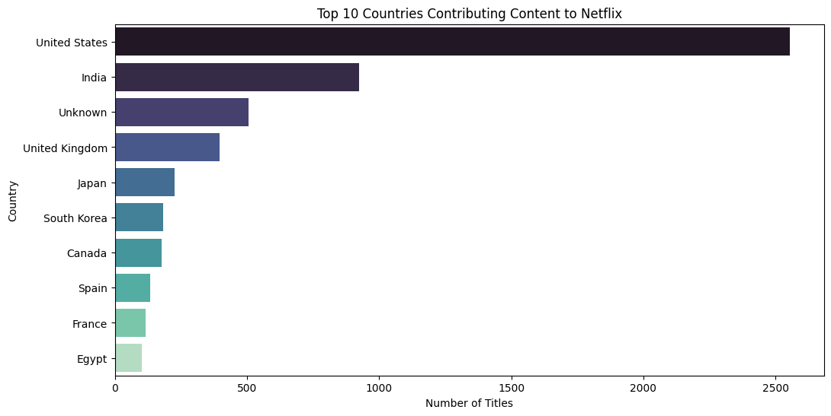
RESULTS3

Slide 9
Strategic Recommendations
Based on the analysis, here are some strategic recommendations for Netflix:
Focus on International Content: The data shows a significant amount of content from countries outside the United States. Continuing to invest in international content can help Netflix grow its global subscriber base.
Invest in Popular Genres: Dramas, Comedies, and International Movies are the most common genres. Netflix should continue to invest in these areas while also exploring niche genres to cater to a wider audience.
Balance Movie and TV Show Production: The data shows a growing trend of both TV shows and movies. Maintaining a healthy balance between these two categories will be crucial for retaining subscribers.

Slide 10
GitHub repository
https://github.com/SivaPrakash-2715/VOIS_AICTE_Oct2025_MajorProject_Siva-Prakash.git

Slide 11

Getting started with Basics of Python Certificate

Slide 12
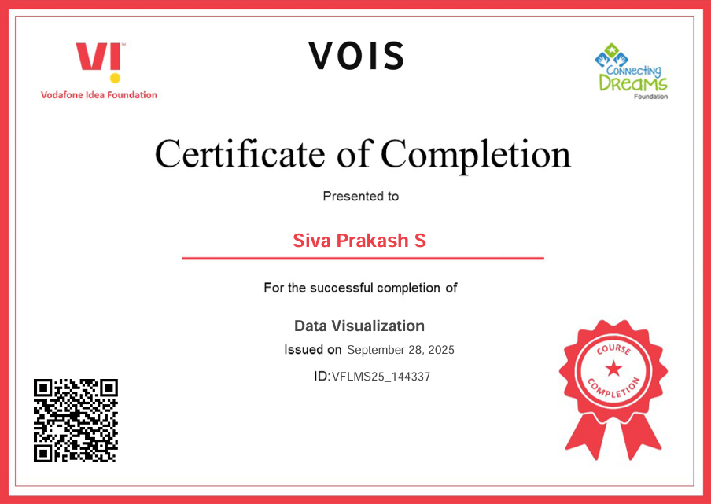
Data Visualization Certificate

Slide 13
Thank you
.
.

